Slide 1
Photo-Anime Translation based on Cycle-Consistent Adversarial Networks
Project of DD2424 Deep Learning in Data Science, Group 7
Yiming Hu Jia Fu Jiarui Tan
https://github.com/Mrstarr/CycleGAN-project

Slide 2
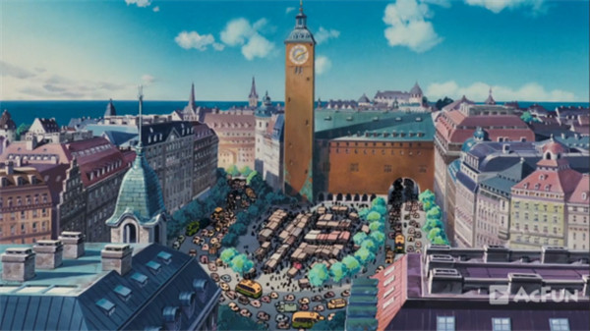
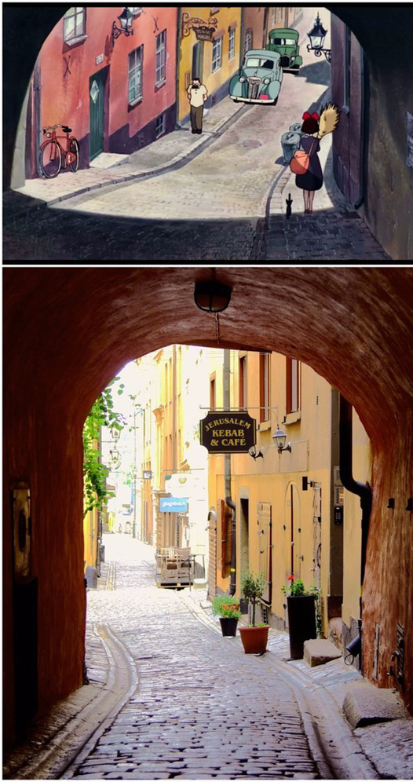
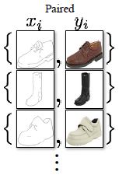
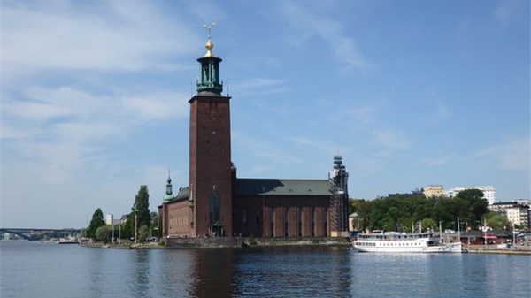
Introduction
Lack
Then, CycleGAN!

Slide 3




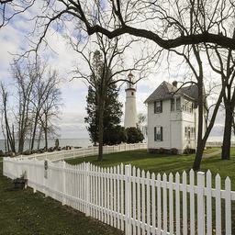
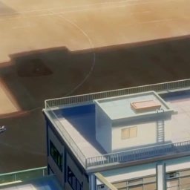

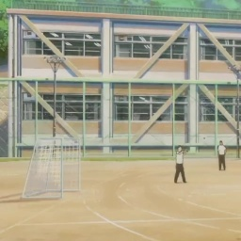
Data: Real2Anime2
trans.Compose([trans.RandomHorizontalFlip(),
trans.Resize((int(CONFIG.size_h * 1.12), int(CONFIG.size_w * 1.12)), Image.BICUBIC),
trans.RandomCrop((CONFIG.size_h, CONFIG.size_w)),
trans.ToTensor(),
trans.Normalize((0.5, 0.5, 0.5), (0.5, 0.5, 0.5))])

Slide 4
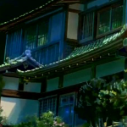
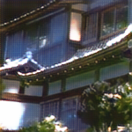
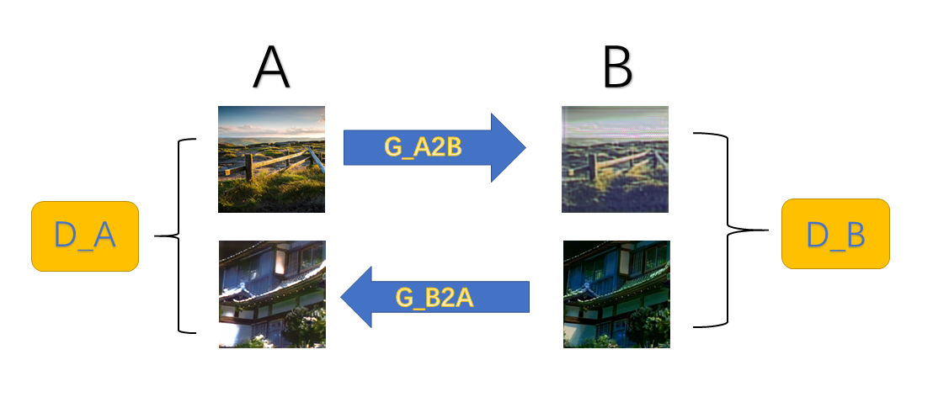
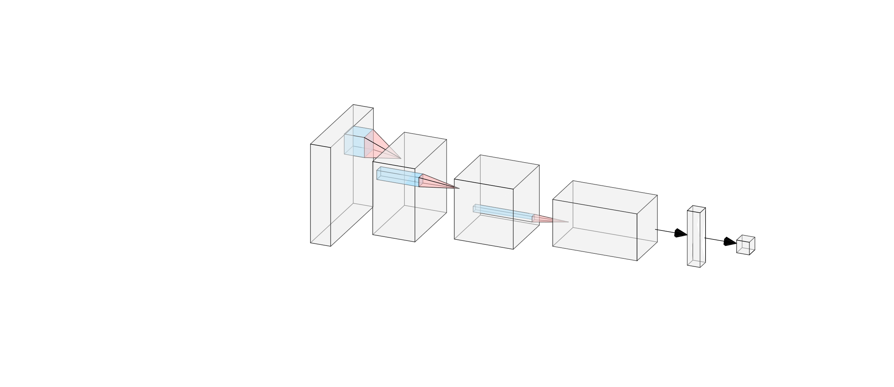
Network Architectures
Conv
ResNet
Transpose
Conv
“Encoder”
“Transformer”
“Decoder”
y=1

Slide 5
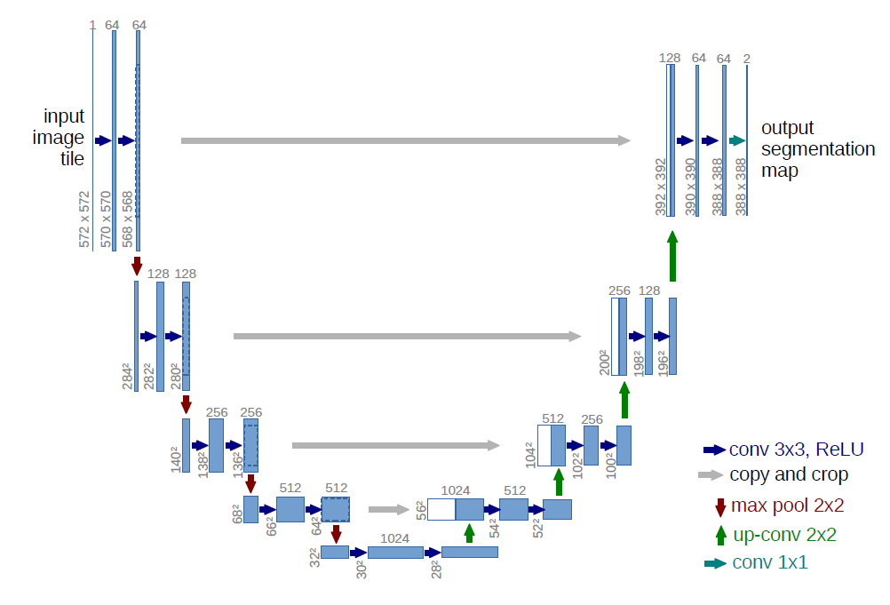
Network Architectures
U-Net

Slide 6
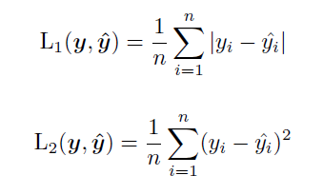
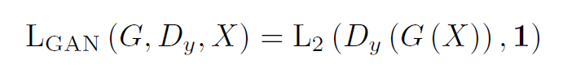
Loss Functions
Generator
Fake
?
Discriminator
Real
adversarial loss

Slide 7
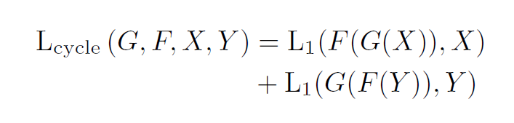
Loss Functions
Generator A→B
Generator
B→A
RealA
FakeB
FakeA
?
cycle consistency loss

Slide 8
Loss Functions
Generator A→B
RealB
FakeB
?
identity loss

Slide 9
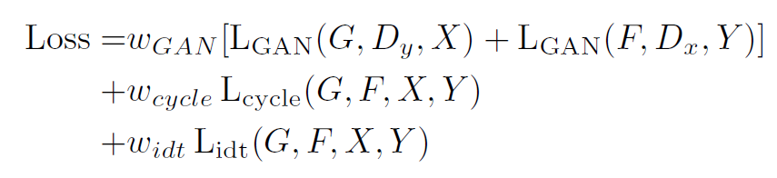
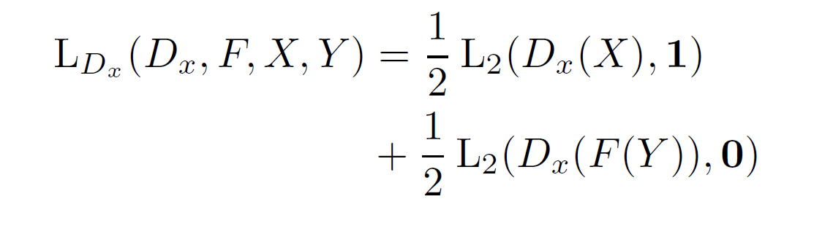
Loss Functions
Generator
Discriminator

Slide 10
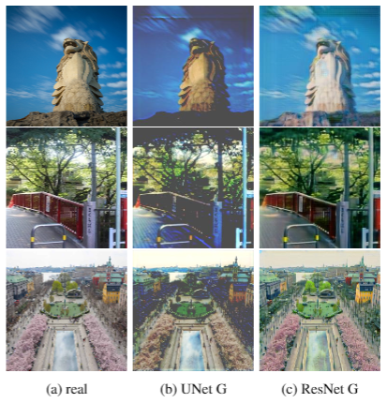
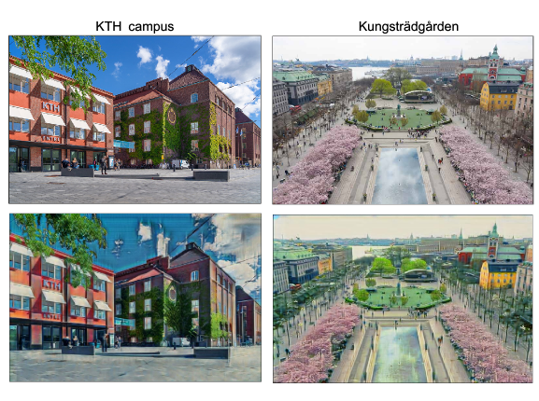
Experiments and Results

Slide 11
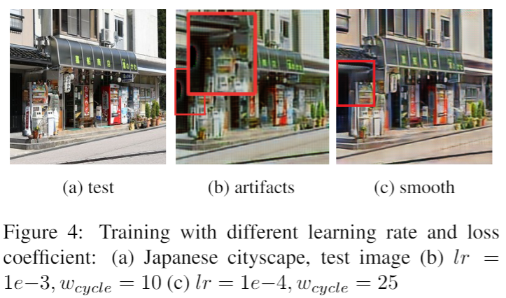
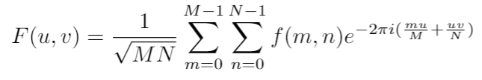
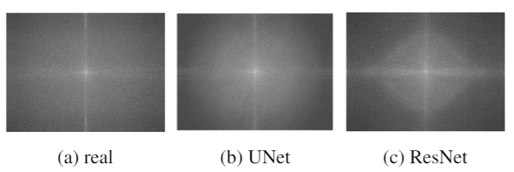
Training Stabilization and Fourier Analysis

Slide 12
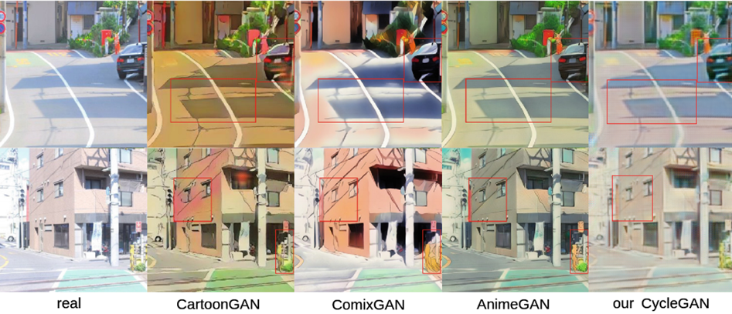
Comparison with latest works

Slide 13
Thank you!

